Slide 1
Hirehive
Overview
With the advancement in he technology , in the world people are trying to get things on the desk without `wasting any time is now days time is the most important thing in the world because of technology people are trying to get knowledge of their jobs as well. Organization also have to advertise about the jobs in newspaper and television which is time consuming.

Slide 2
Introduction
In this portal different organizations, institution , etc. display/advertise jobs according to their requirements so that the people or jobs seekers view the different kind of jobs and the further information about the related organization. Organization also check the CV’s of the job seekers if the he/she full fill the organization , it hire’s or contact them for the job.

Slide 3
purpose
The purpose of designing the online job portal is to give the job seekers to platform for finding the right and a satisfactory job according to their qualification. It also connect the job seekers with the major organization.

Slide 4
Scope
This job scope of the online job portal includes :
The online job portal system that is to be developed provides the members with jobs information , online applying for jobs and many other facilities. The basic scope of the project is giving under.
Employee/ job seekers
Employee/ job provider
Admin of site
Admin of company

Slide 5
Tools & technology
Php
HTML
MySql
CSS
Java script
Bootstrap
Visual studio
XAMPP

Slide 6
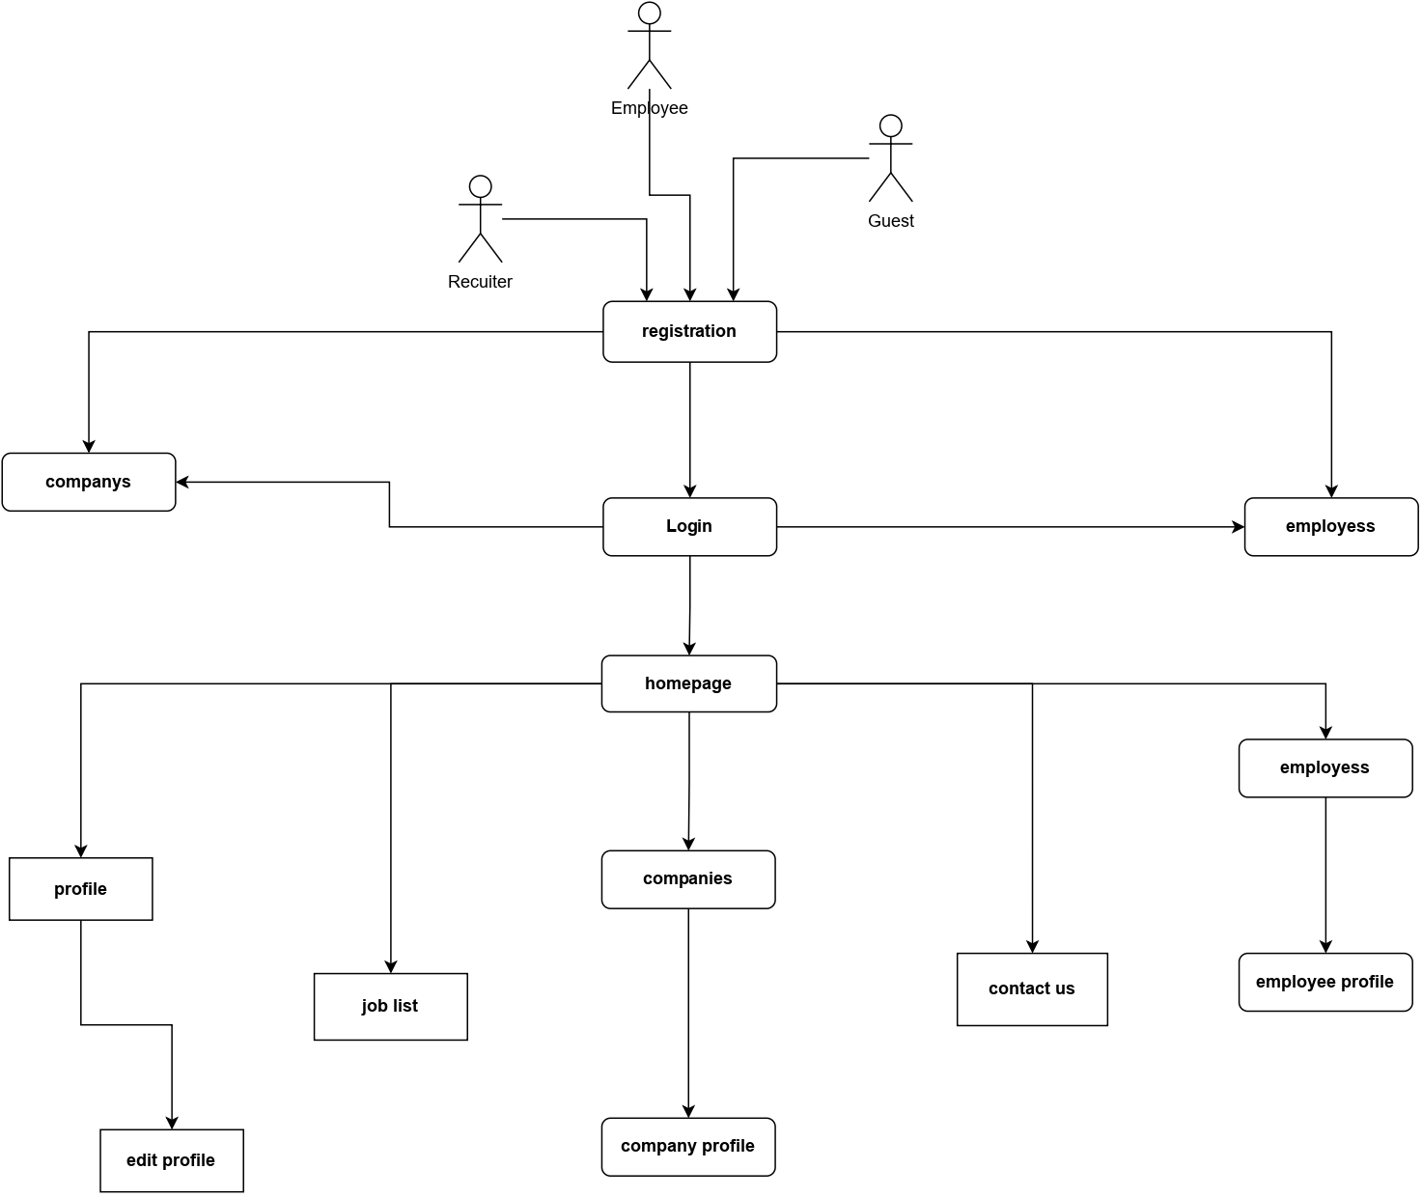

Slide 7
